Slide 1
Chapter 8
Root Locus Techniques

Slide 2
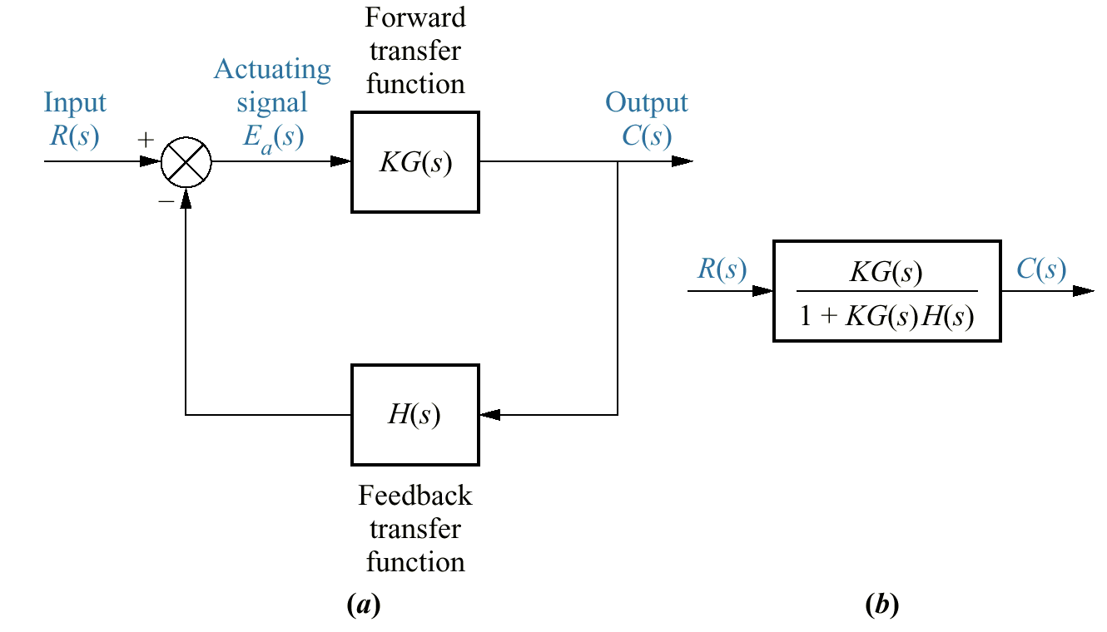
Figure 8.1
a. Closed- loop
system;
b. equivalent transfer
function

Slide 3
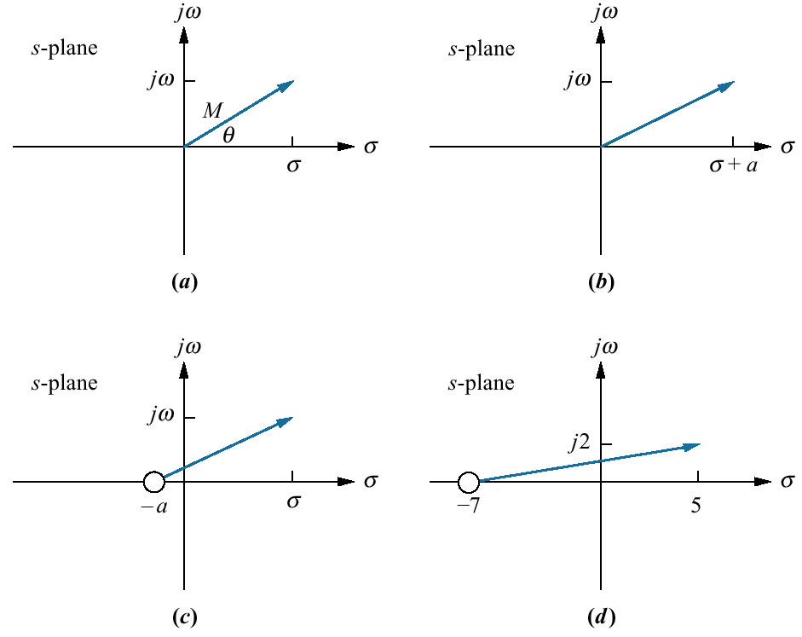
Figure 8.2
Vector representation
of complex numbers:
a. 5 = σ + jω;
b. (s + a);
c. alternate
representation
of (s + a);
d. (s + 7)|_{s→5 + j2}

Slide 4
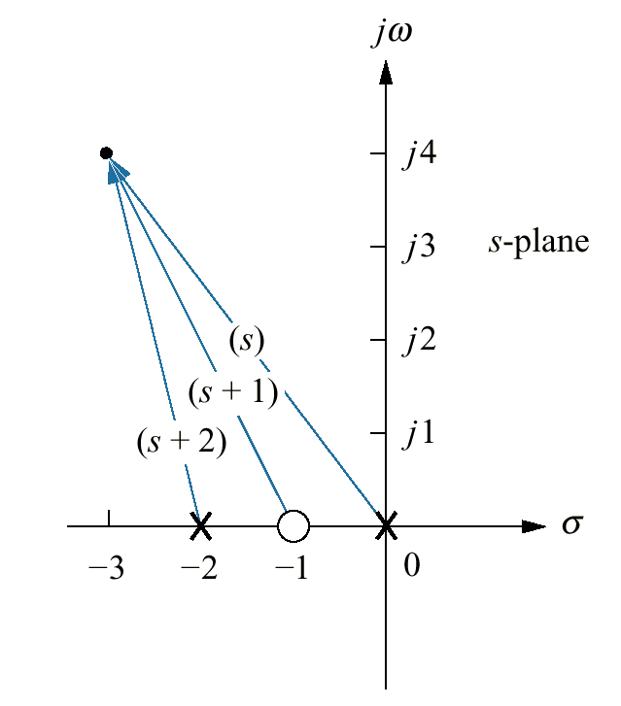
Figure 8.3
Vector representation
of Eq. (8.7)

Slide 5
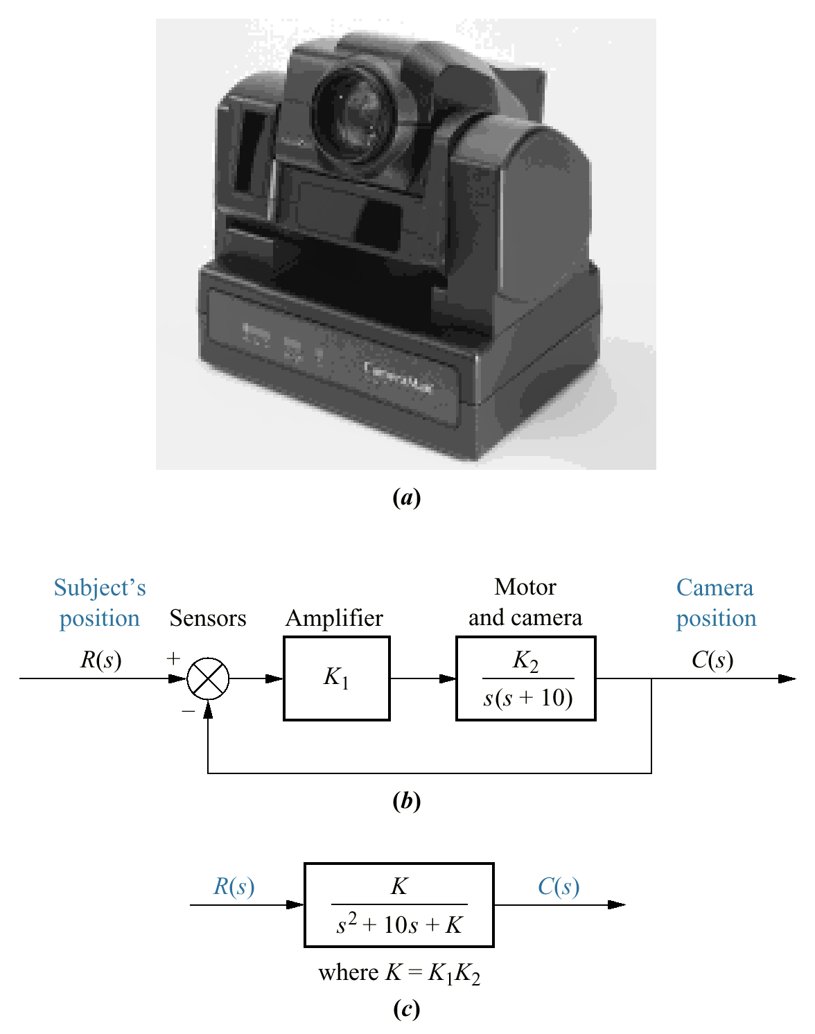
Figure 8.4
a.
CameraMan®
Presenter Camera
System automatically
follows a subject
who wears infrared
sensors on their
front and back (the
front sensor is also a
microphone); tracking
commands and
audio are relayed to
CameraMan via a
radio frequency link
from a unit worn by
the subject;
b. block diagram;
c. closed-loop
transfer function

Slide 6
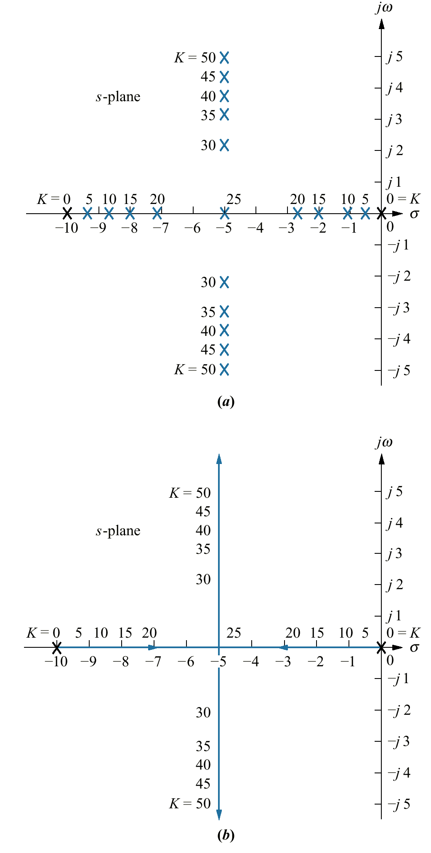
Figure 8.5
a. Pole plot from
Table 8.1;
b. root locus

Slide 7
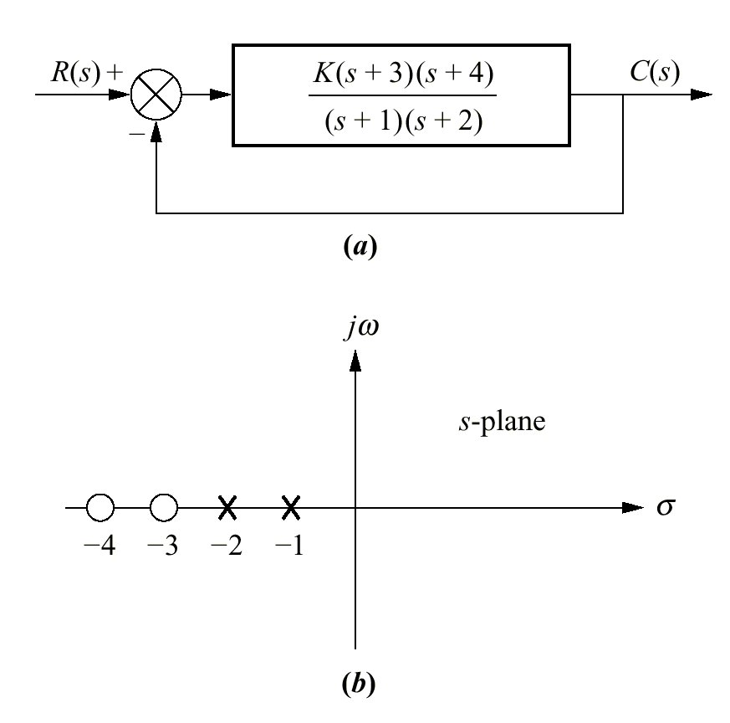
Figure 8.6
a. Example system;
b. pole-zero plot of
G (s)

Slide 8
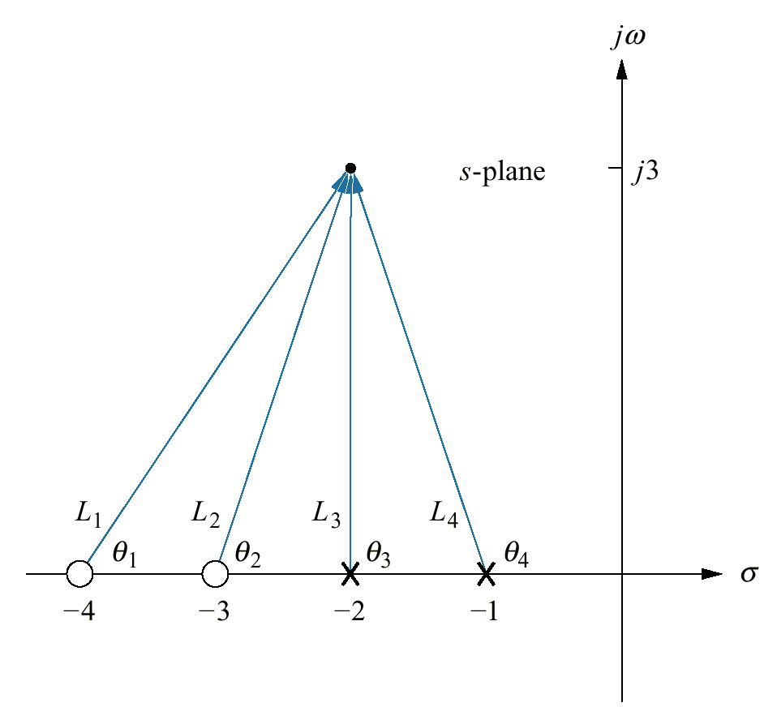
Figure 8.7
Vector representation
of G(s) from Figure
8.6(a) at -2+ j3

Slide 9
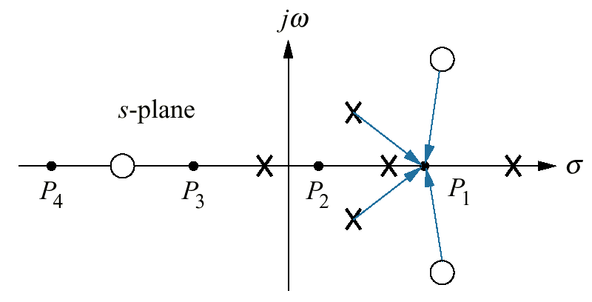
Figure 8.8
Poles and zeros
of a general
open-loop
system with
test points,
P_{j}, on the
real axis

Slide 10
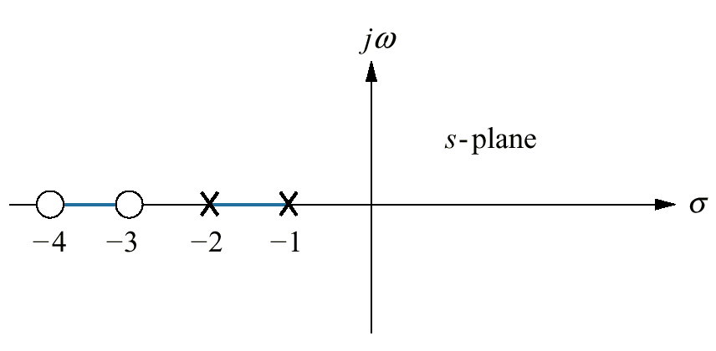
Figure 8.9
Real- axis segments of
the root locus for the
system of Figure 8.6

Slide 11
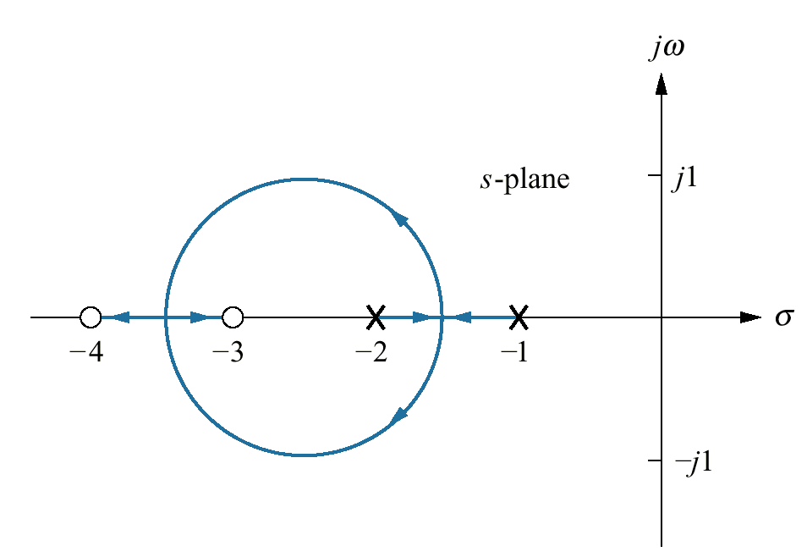
Figure 8.10
Complete root
locus for the
system of
Figure 8.6

Slide 12
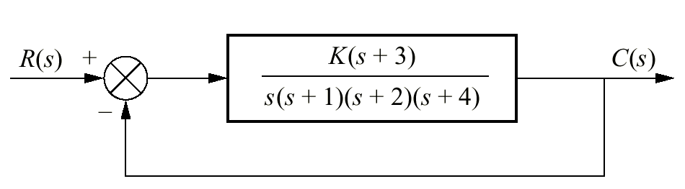
Figure 8.11
System for
Example 8.2

Slide 13
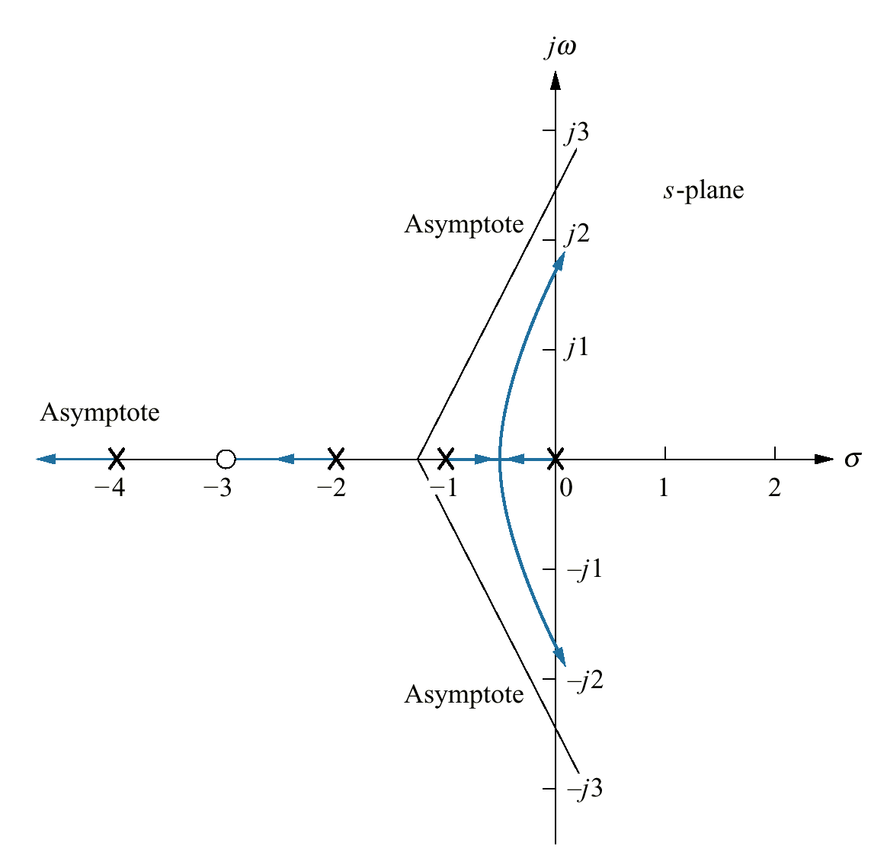
Figure 8.12
Root locus and
asymptotes for the
system of Figure 8.11

Slide 14
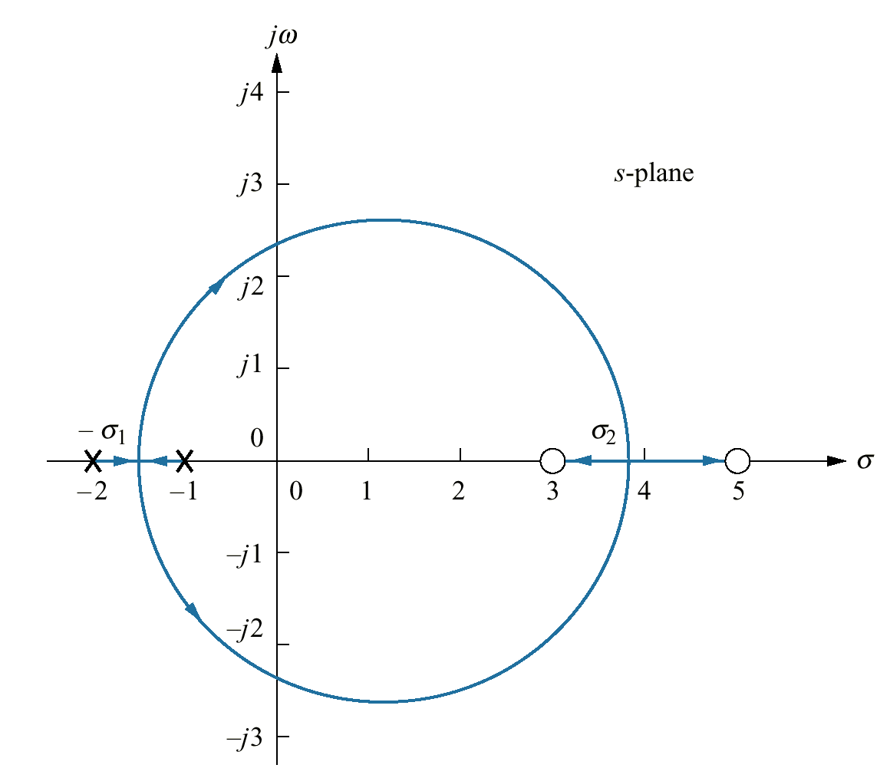
Figure 8.13
Root locus example
showing real- axis
breakaway (=σ₁) and
break-in points (σ₂)

Slide 15
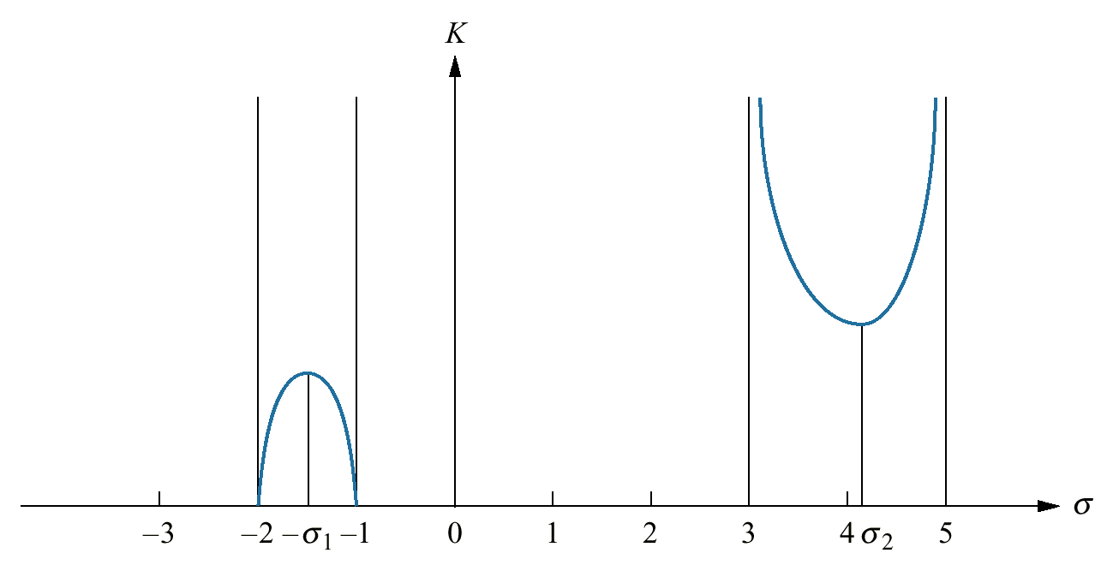
Figure 8.14
Variation of gain
along the real axis for
the root locus of
Figure 8.13

Slide 16
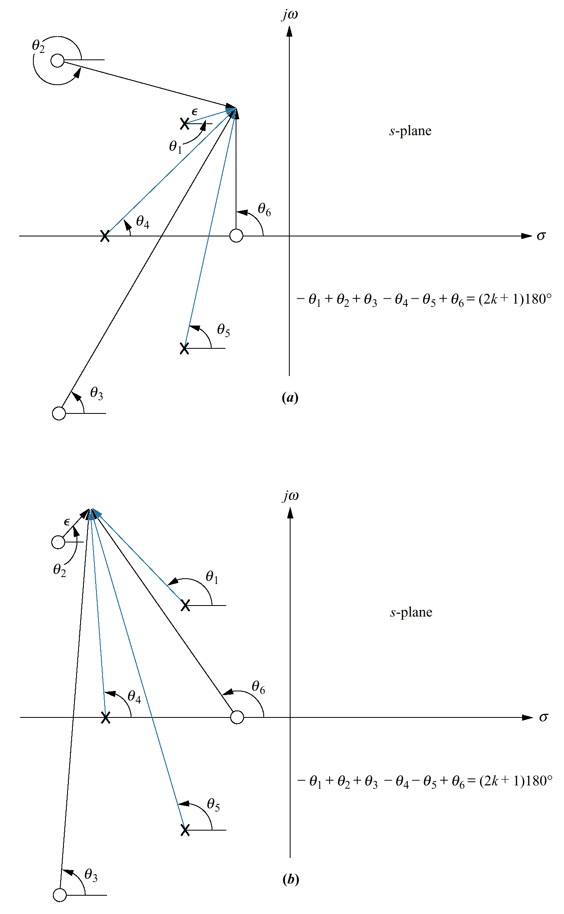
Figure 8.15
Open- loop poles
and zeros and
calculation of:
a. angle of departure;
b. angle of arrival

Slide 17
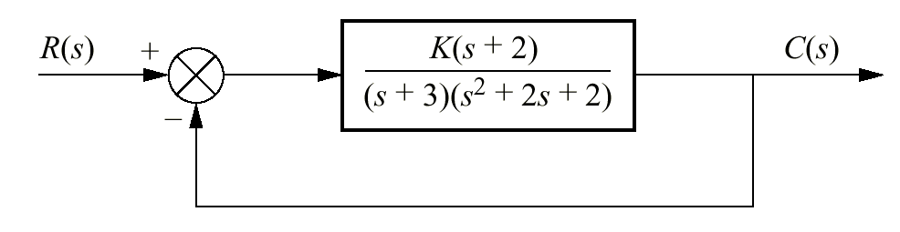
Figure 8.16
Unity feedback system
with complex poles

Slide 18
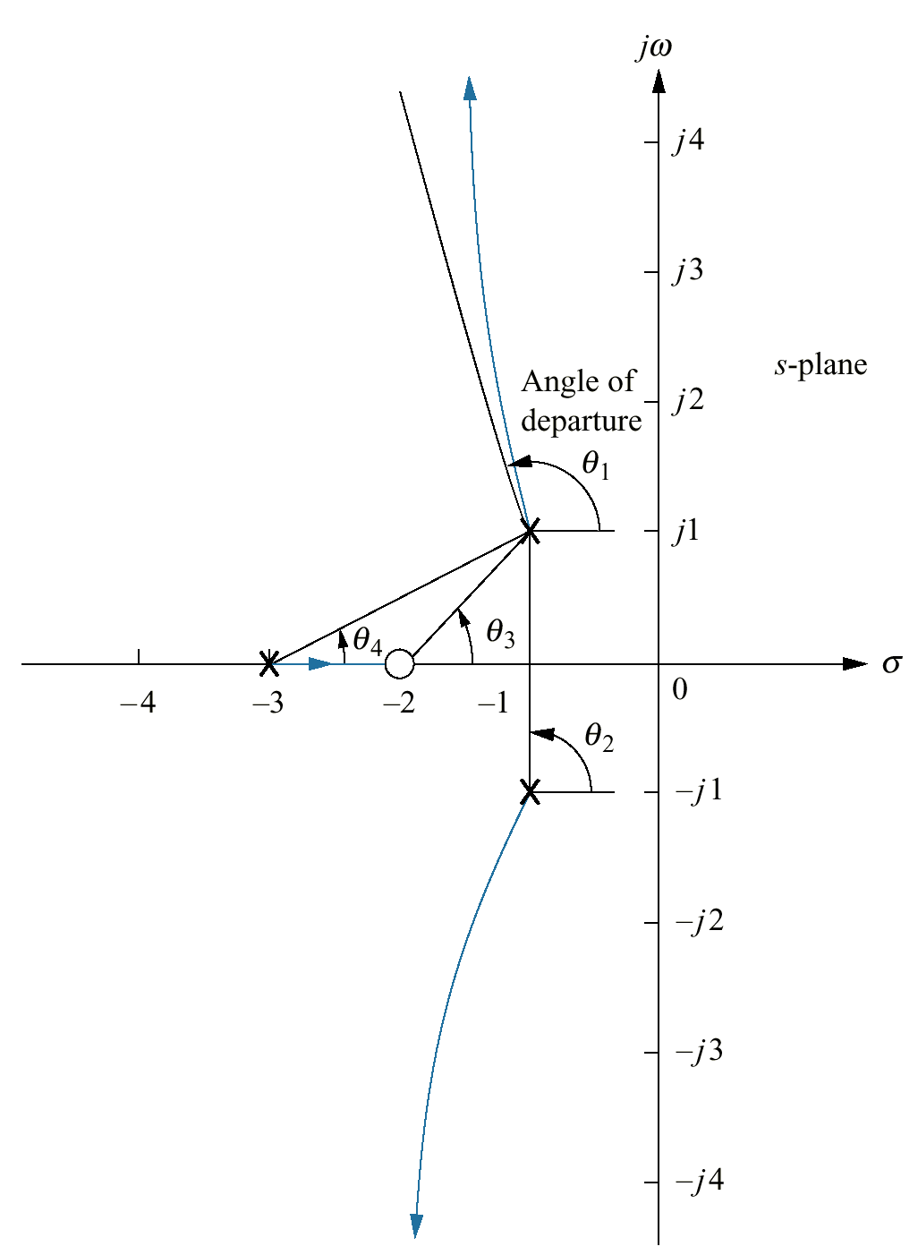
Figure 8.17
Root locus for system
of Figure 8.16
showing angle of
departure

Slide 19
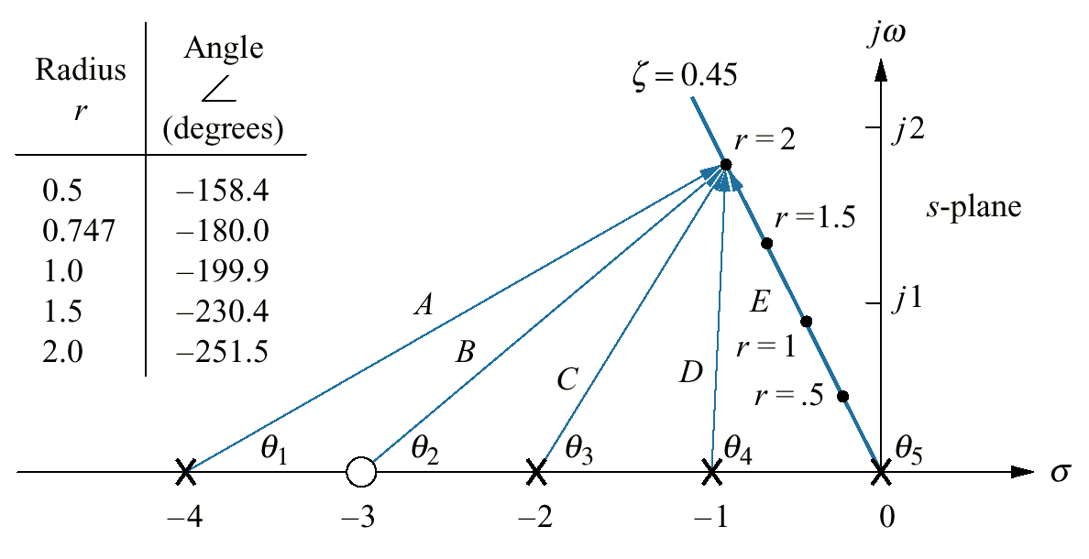
Figure 8.18
Finding and calibrating
exact points on
the root locus of
Figure 8.12

Slide 20
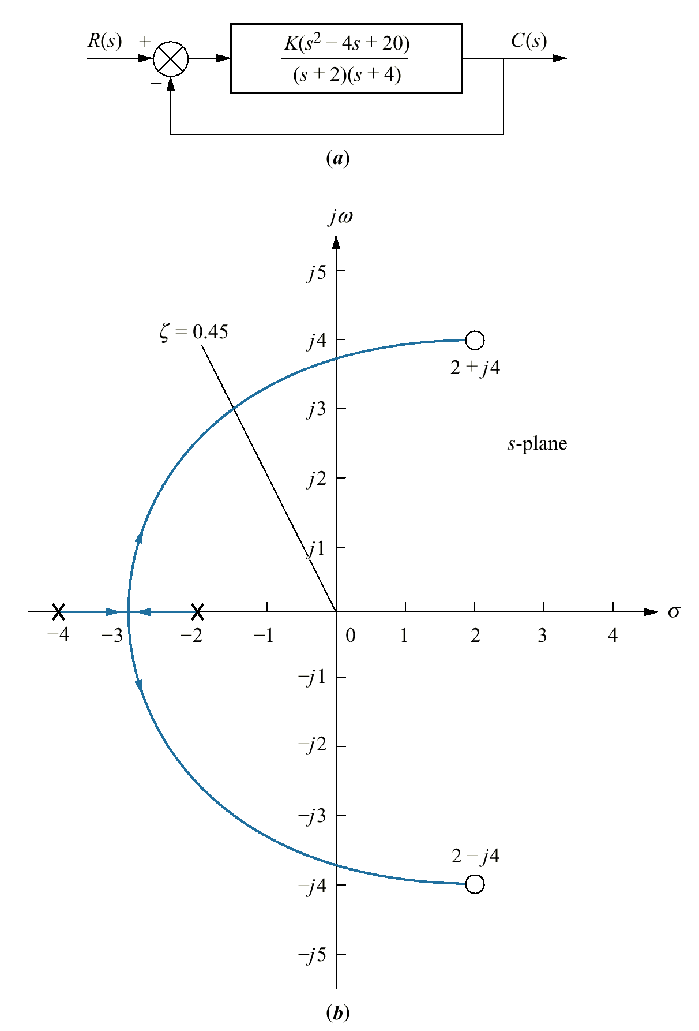
Figure 8.19
a. System for
Example 8.7;
b. root locus sketch

Slide 21
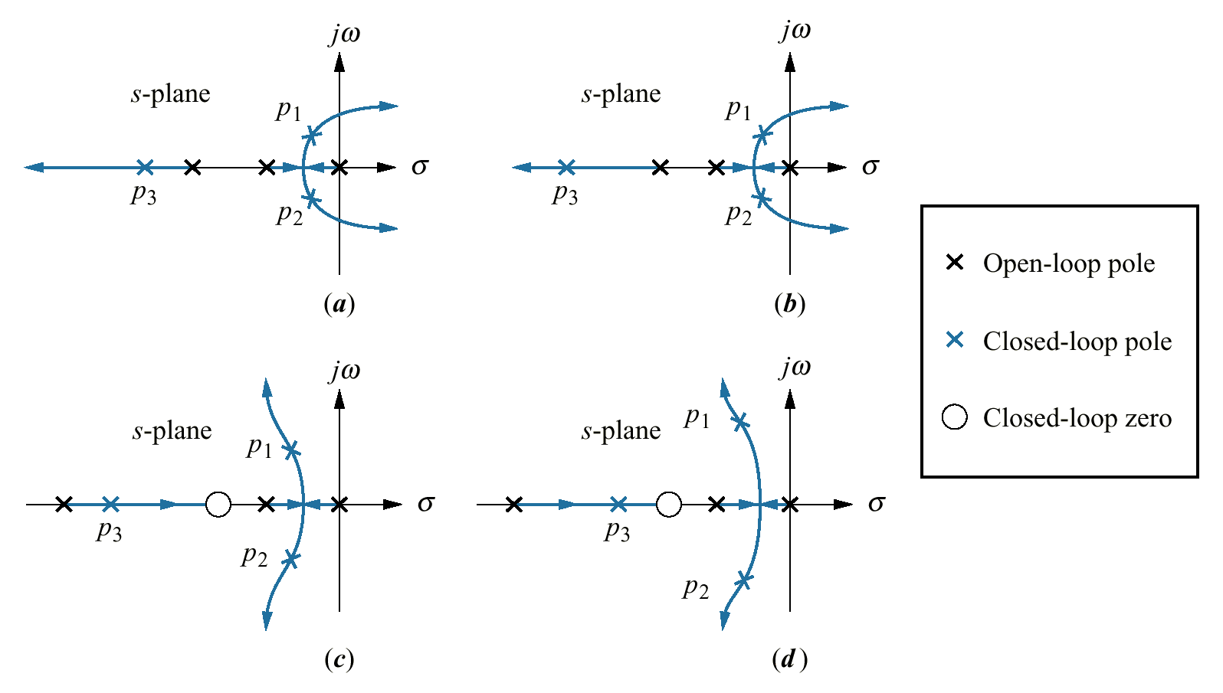
Figure 8.20
Making second- order
approximations

Slide 22
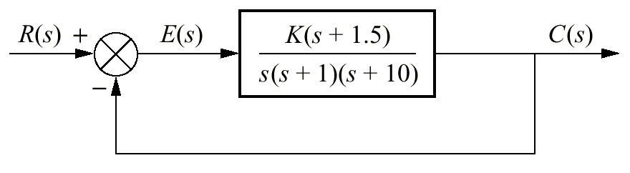
Figure 8.21
System for
Example 8.8

Slide 23
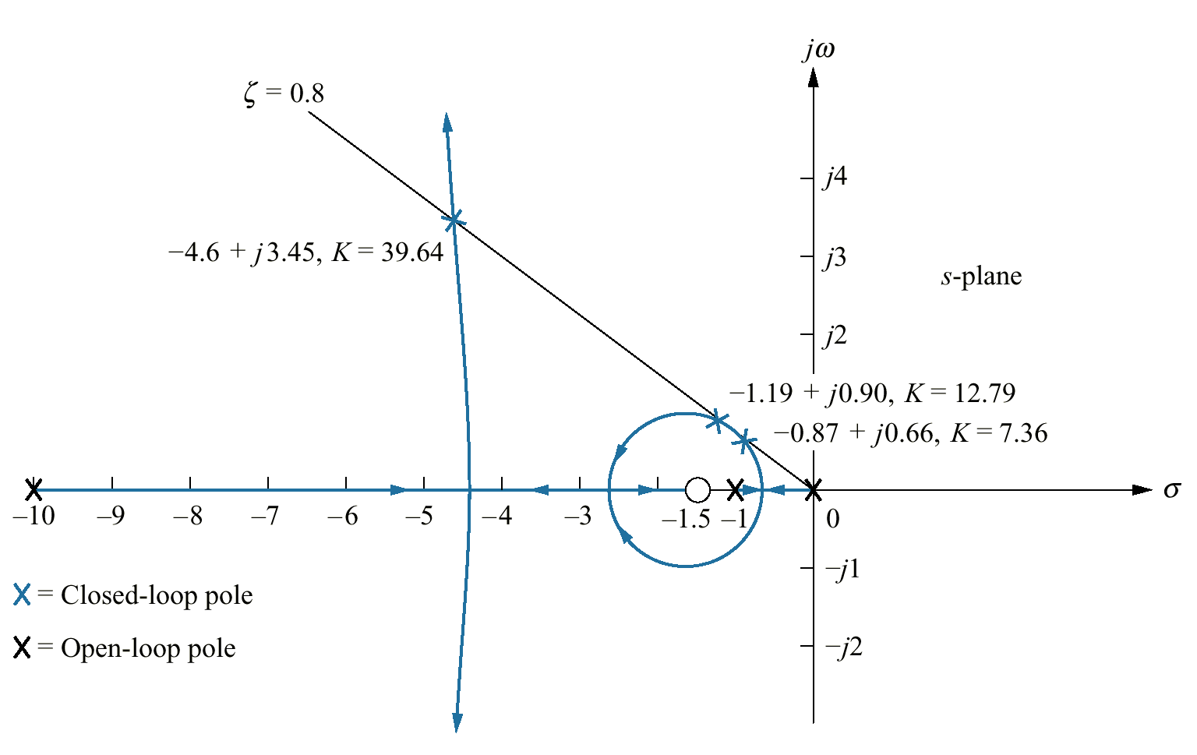
Figure 8.22
Root locus for
Example 8.8

Slide 24
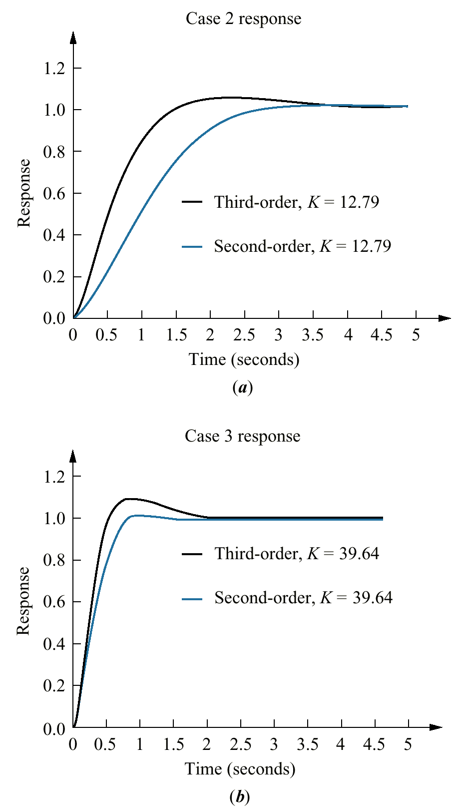
Figure 8.23
Second- and third-order
responses for
Example 8.8:
a. Case 2;
b. Case 3

Slide 25
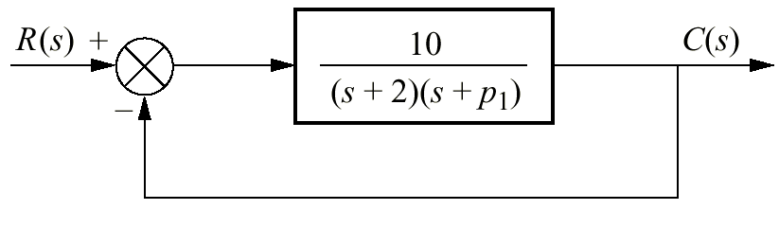
Figure 8.24
System requiring a
root locus calibrated
with p1 as a
parameter

Slide 26
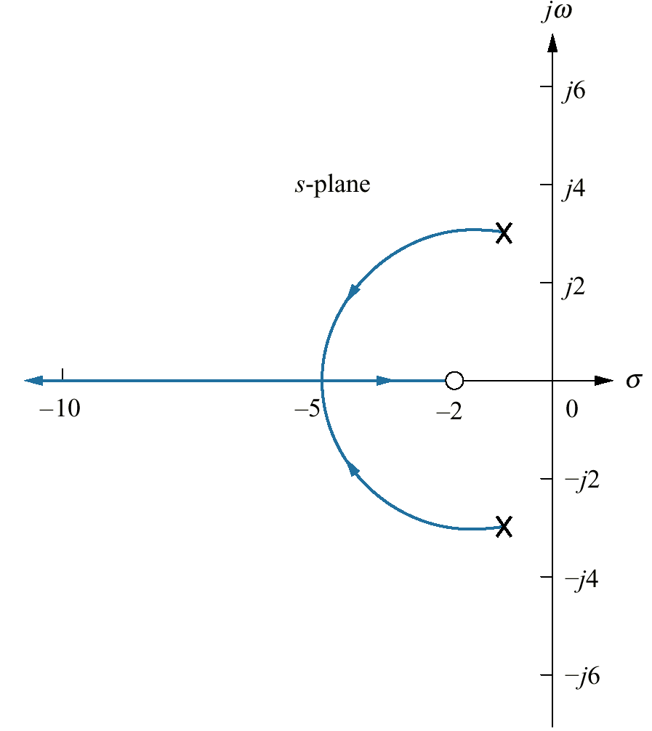
Figure 8.25
Root locus for the
system of Figure
8.24, with p1 as a
parameter

Slide 27
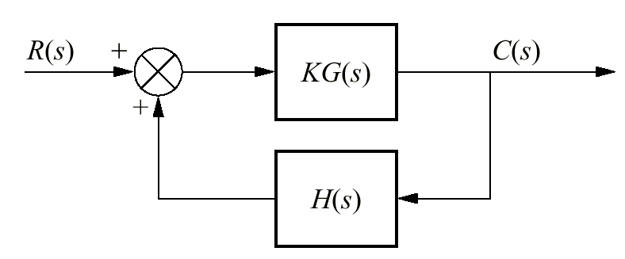
Figure 8.26
Positive-feedback
system

Slide 28
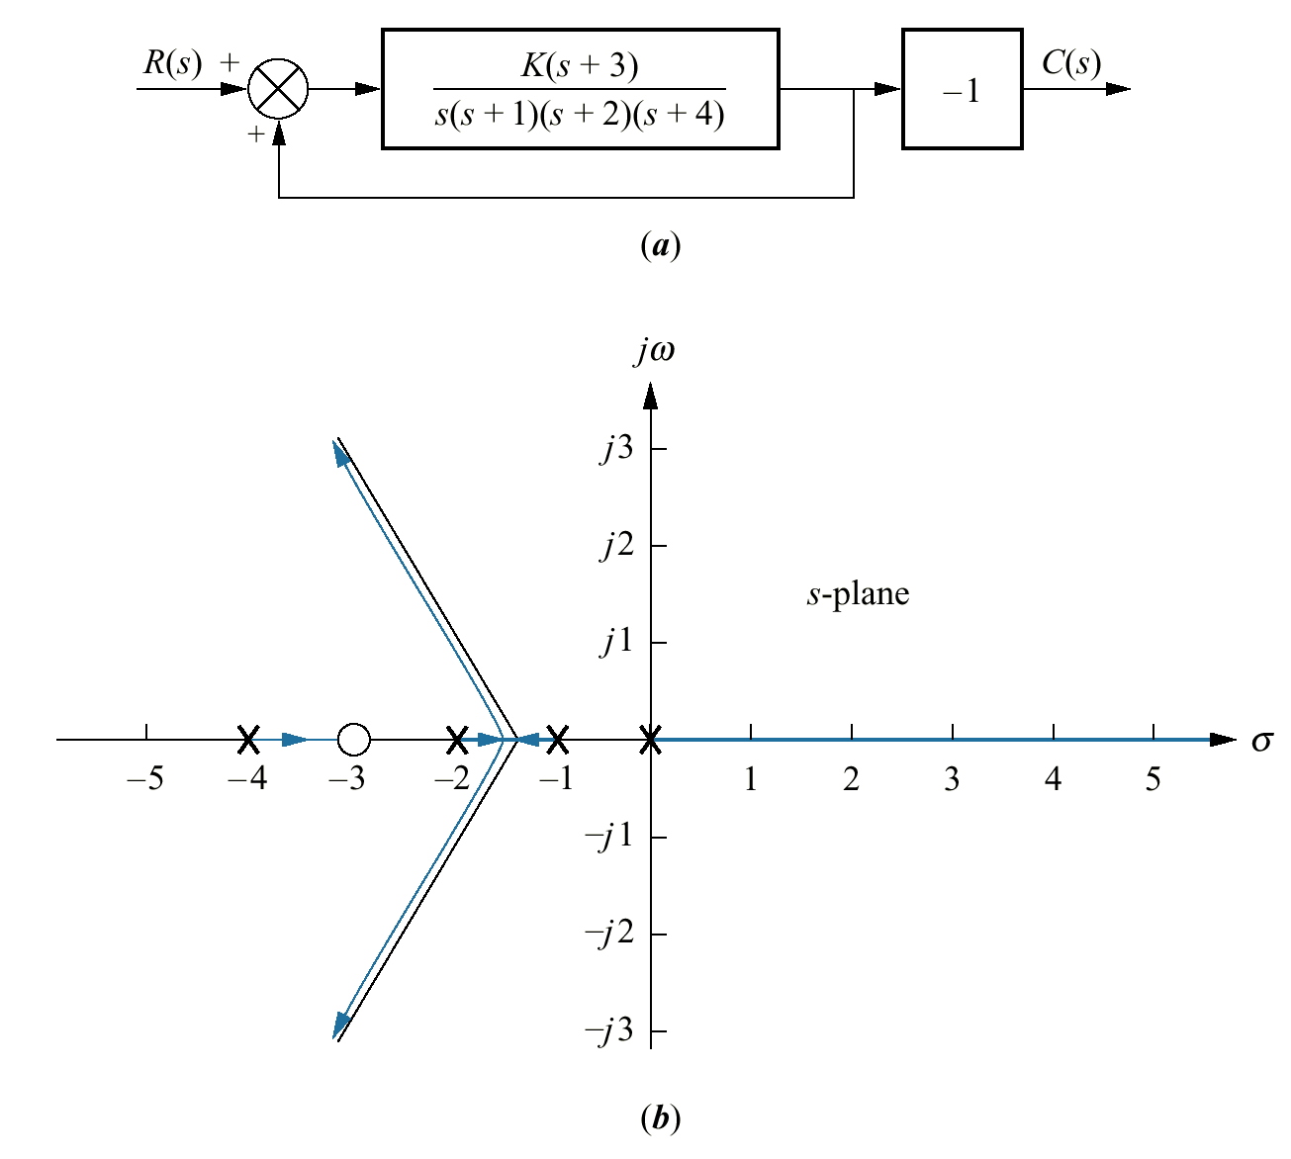
Figure 8.27
a. Equivalent positive-
feedback system for
Example 8.9;
b. root locus

Slide 29
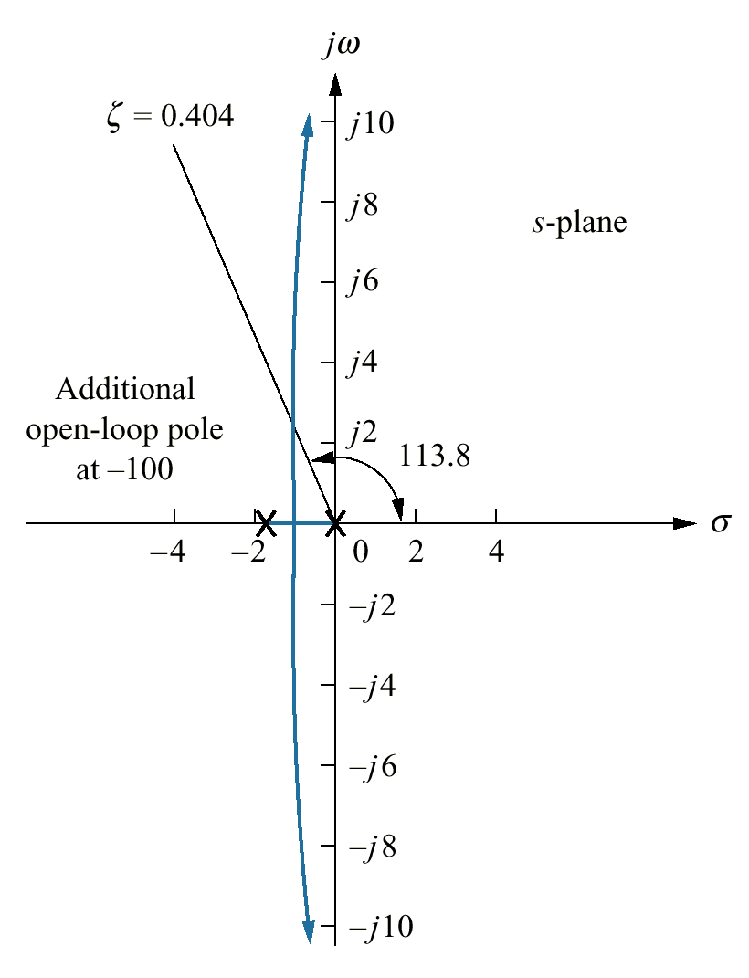
Figure 8.28
Portion of the root
locus for the antenna
control system

Slide 30
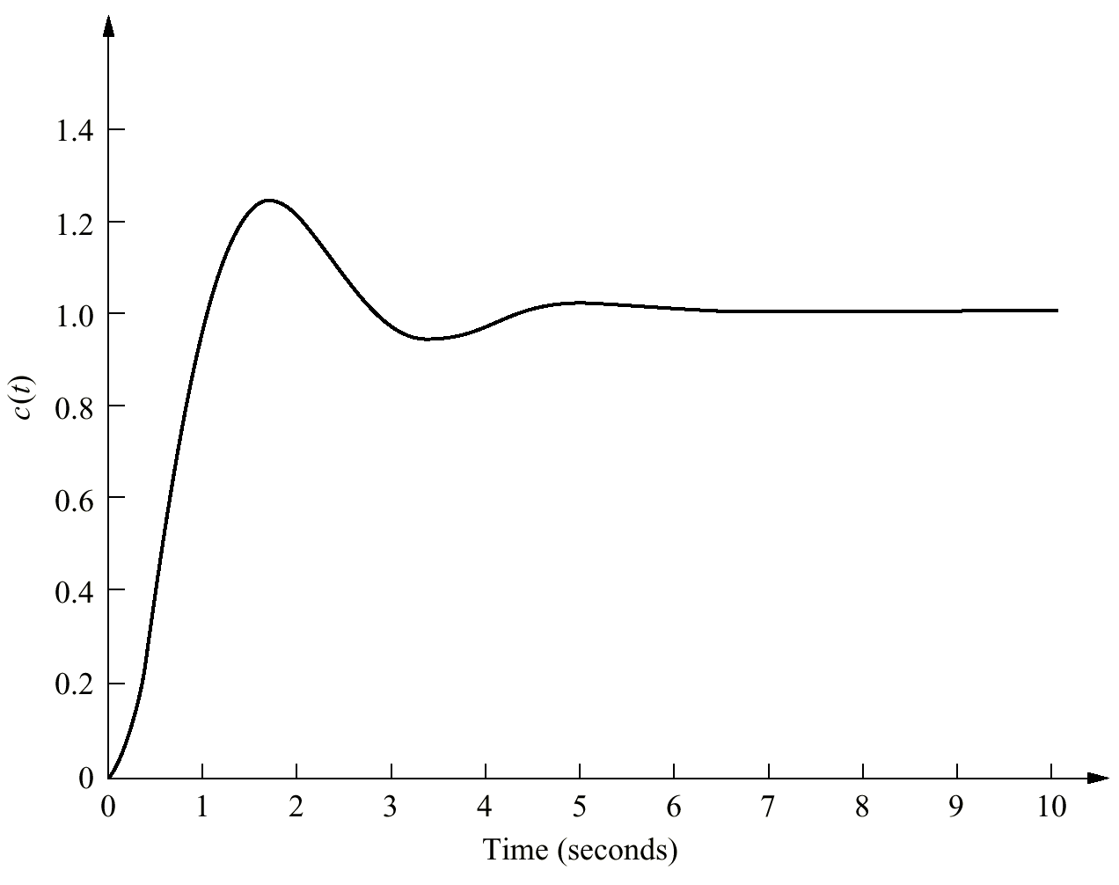
Figure 8.29
Step response of the
gain-adjusted antenna
control system

Slide 31
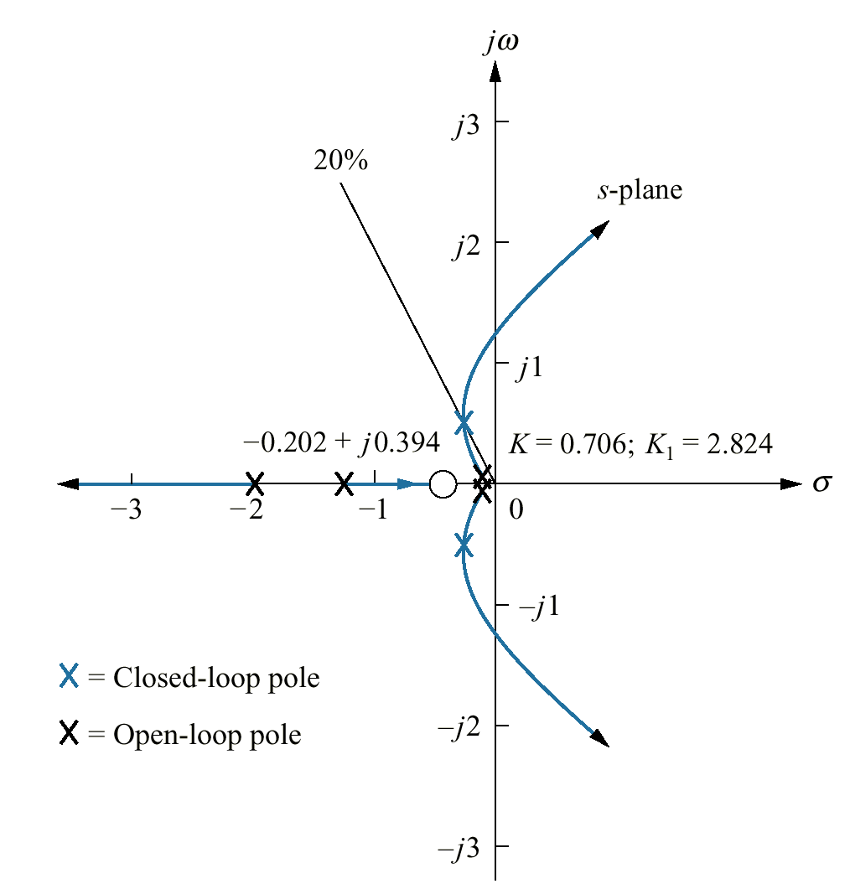
Figure 8.30
Root locus of pitch
control loop without
rate feedback, UFSS
vehicle

Slide 32
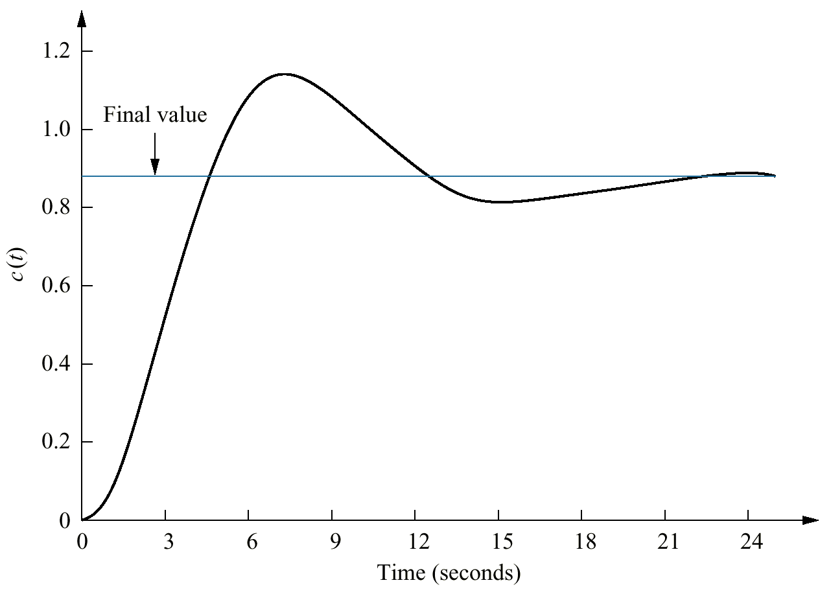
Figure 8.31 Computer simulation
of step response of
pitch control loop
without rate feedback,
UFSS vehicle

Slide 33
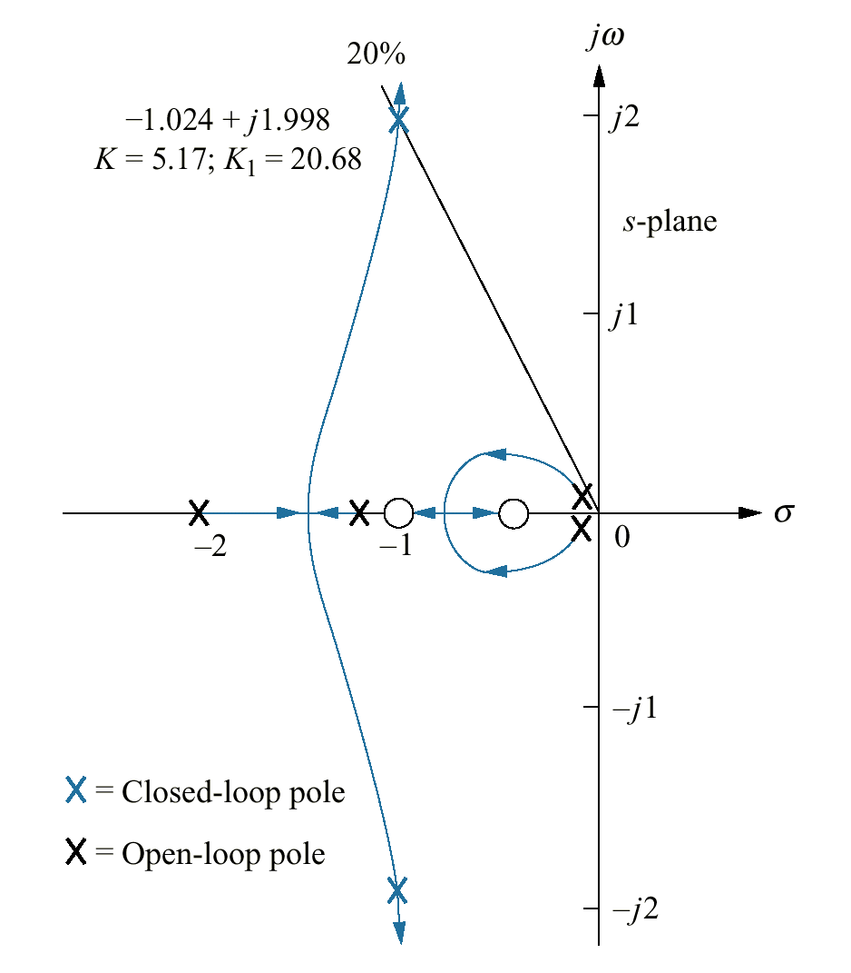
Figure 8.32
Root locus of pitch
control loop with
rate feedback, UFSS
vehicle

Slide 34
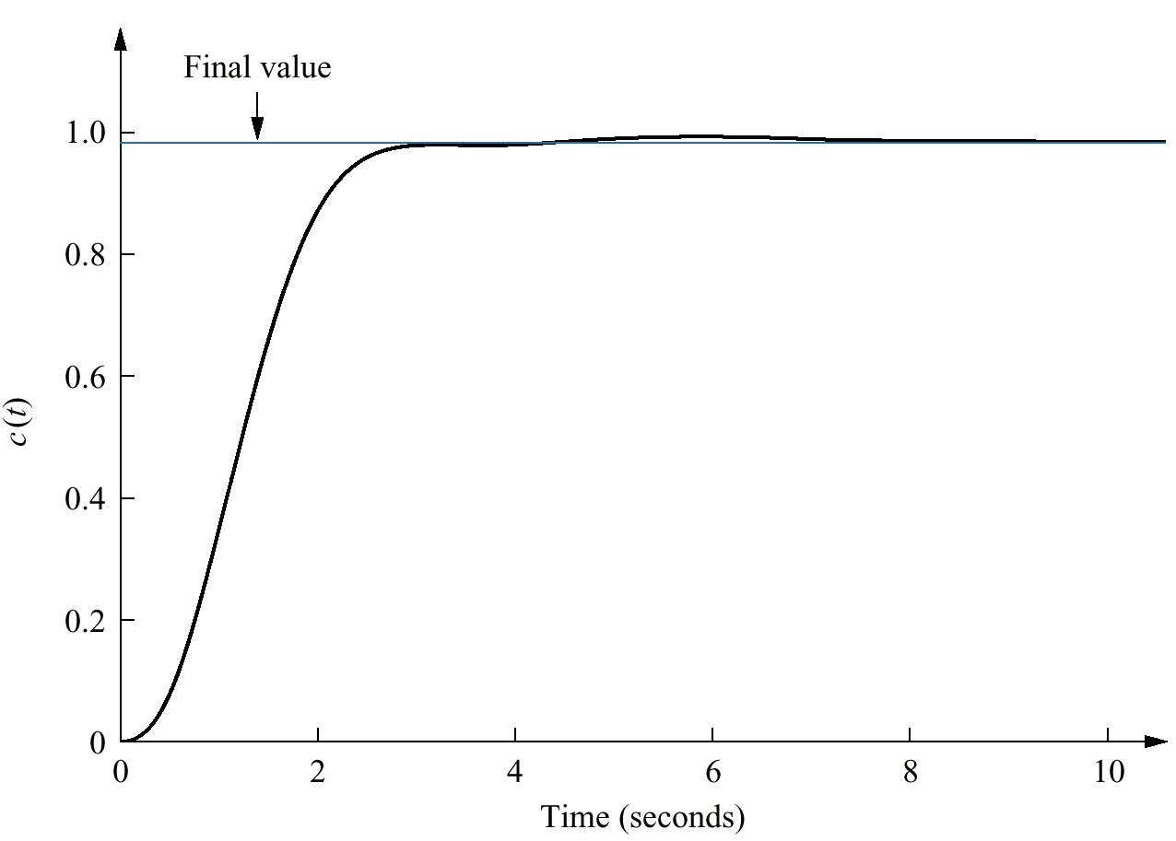
Figure 8.33
Computer simulation
of step response of
pitch control loop with
rate feedback, UFSS
vehicle

Slide 35
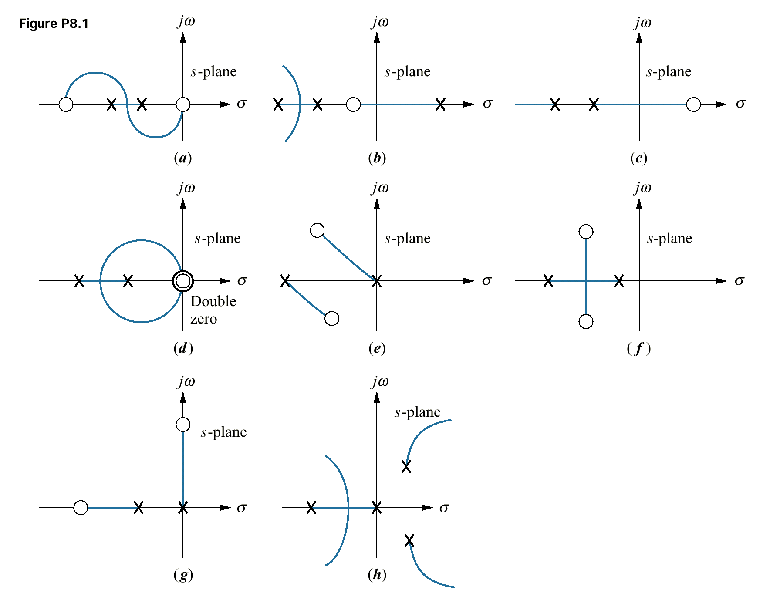
Figure P8.1

Slide 36
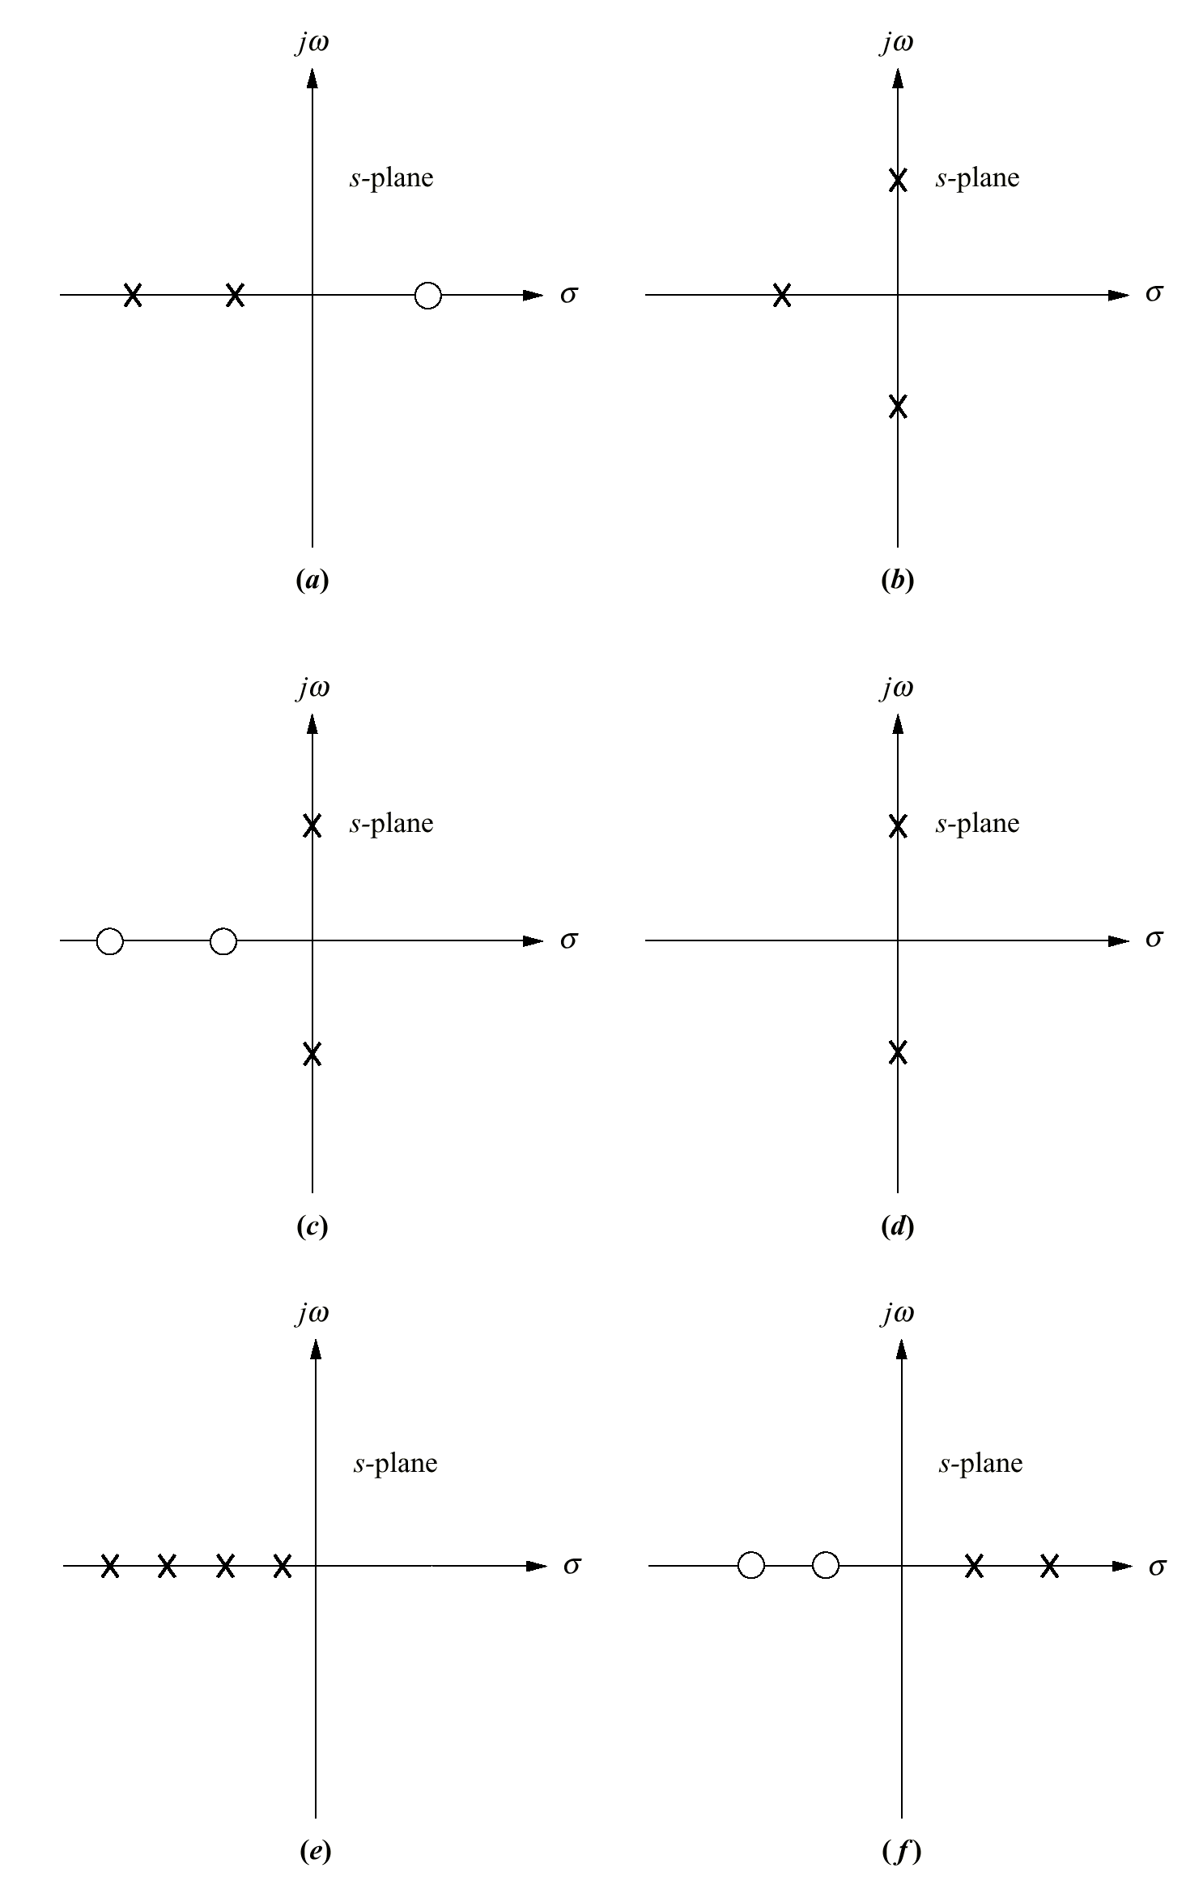
Figure P8.2

Slide 37
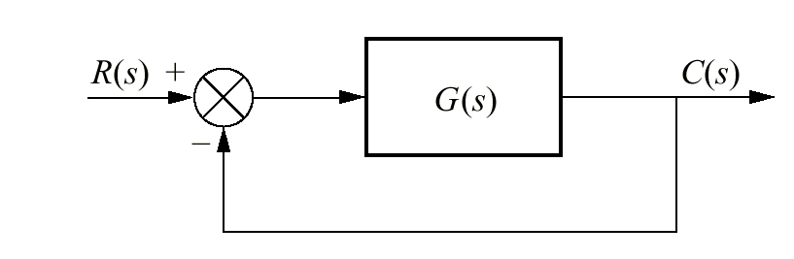
Figure P8.3

Slide 38
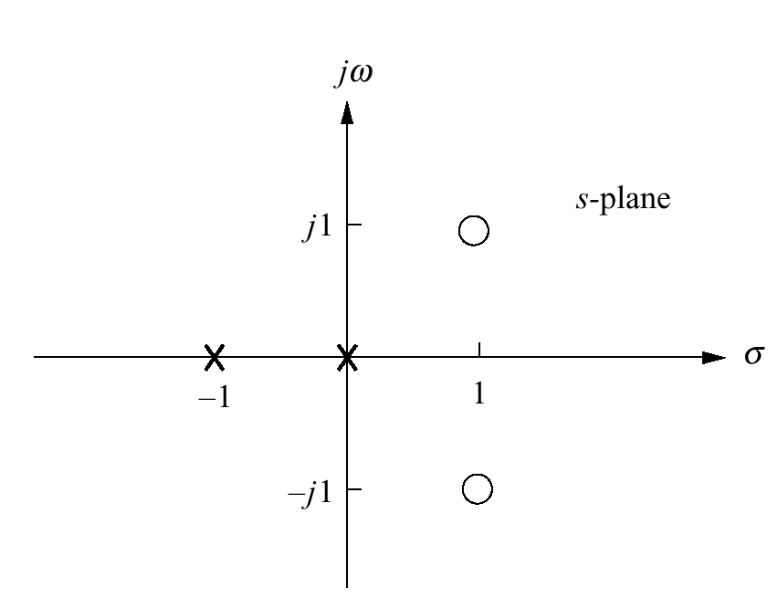
Figure P8.4

Slide 39
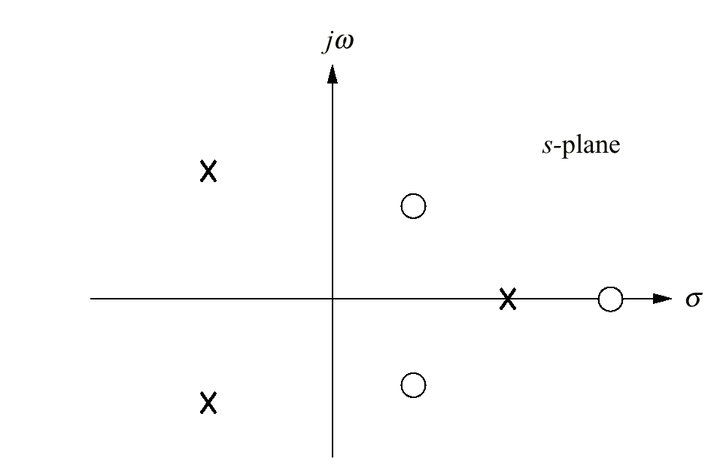
Figure P8.5

Slide 40
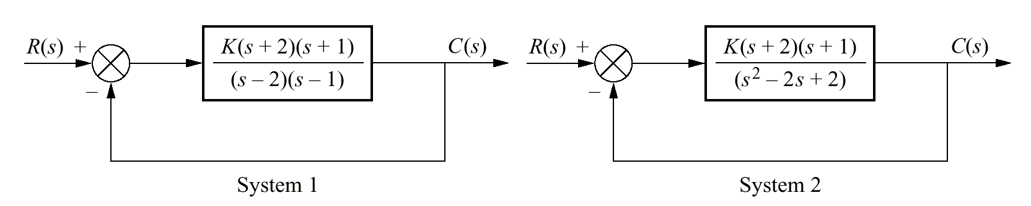
Figure P8.6

Slide 41
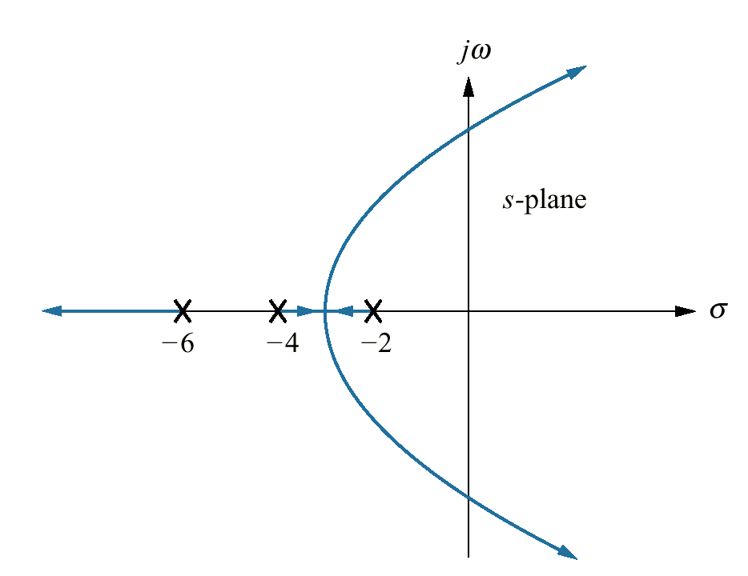
Figure P8.7

Slide 42
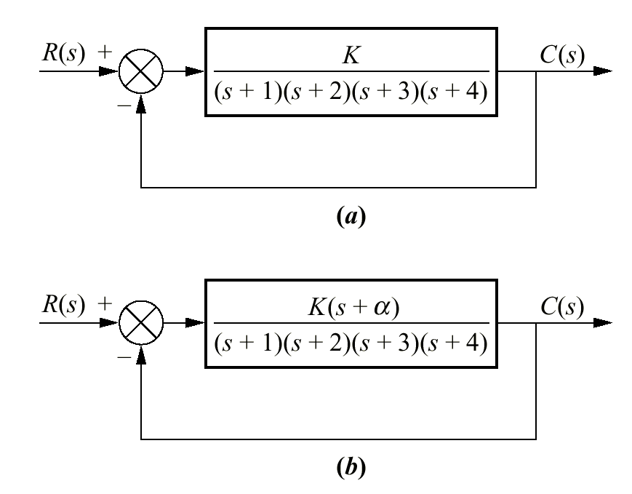
Figure P8.8

Slide 43
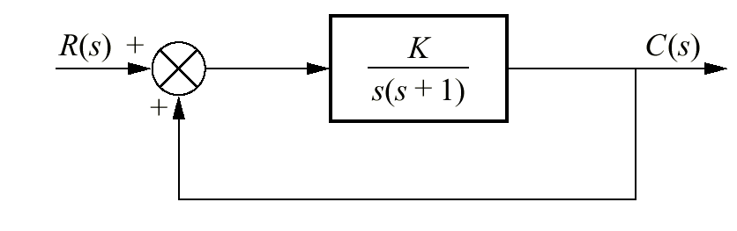
Figure P8.9

Slide 44
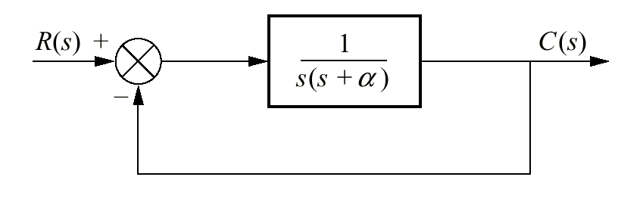
Figure P8.10

Slide 45
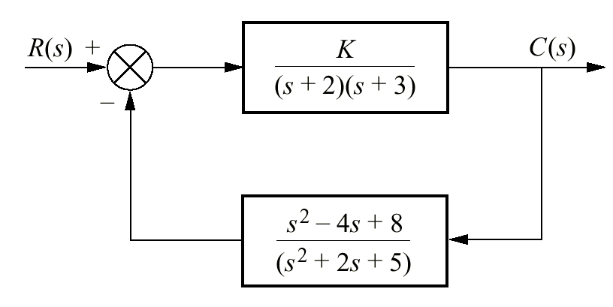
Figure P8.11

Slide 46
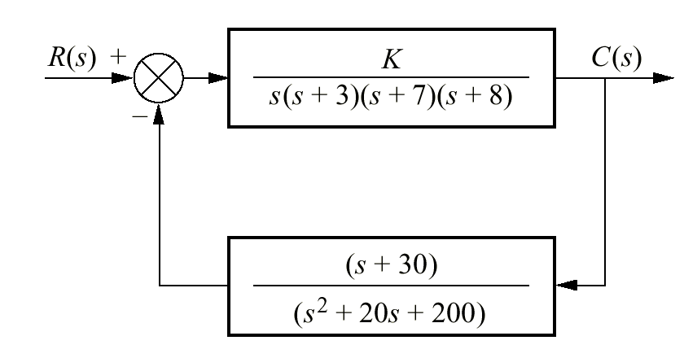
Figure P8.12

Slide 47
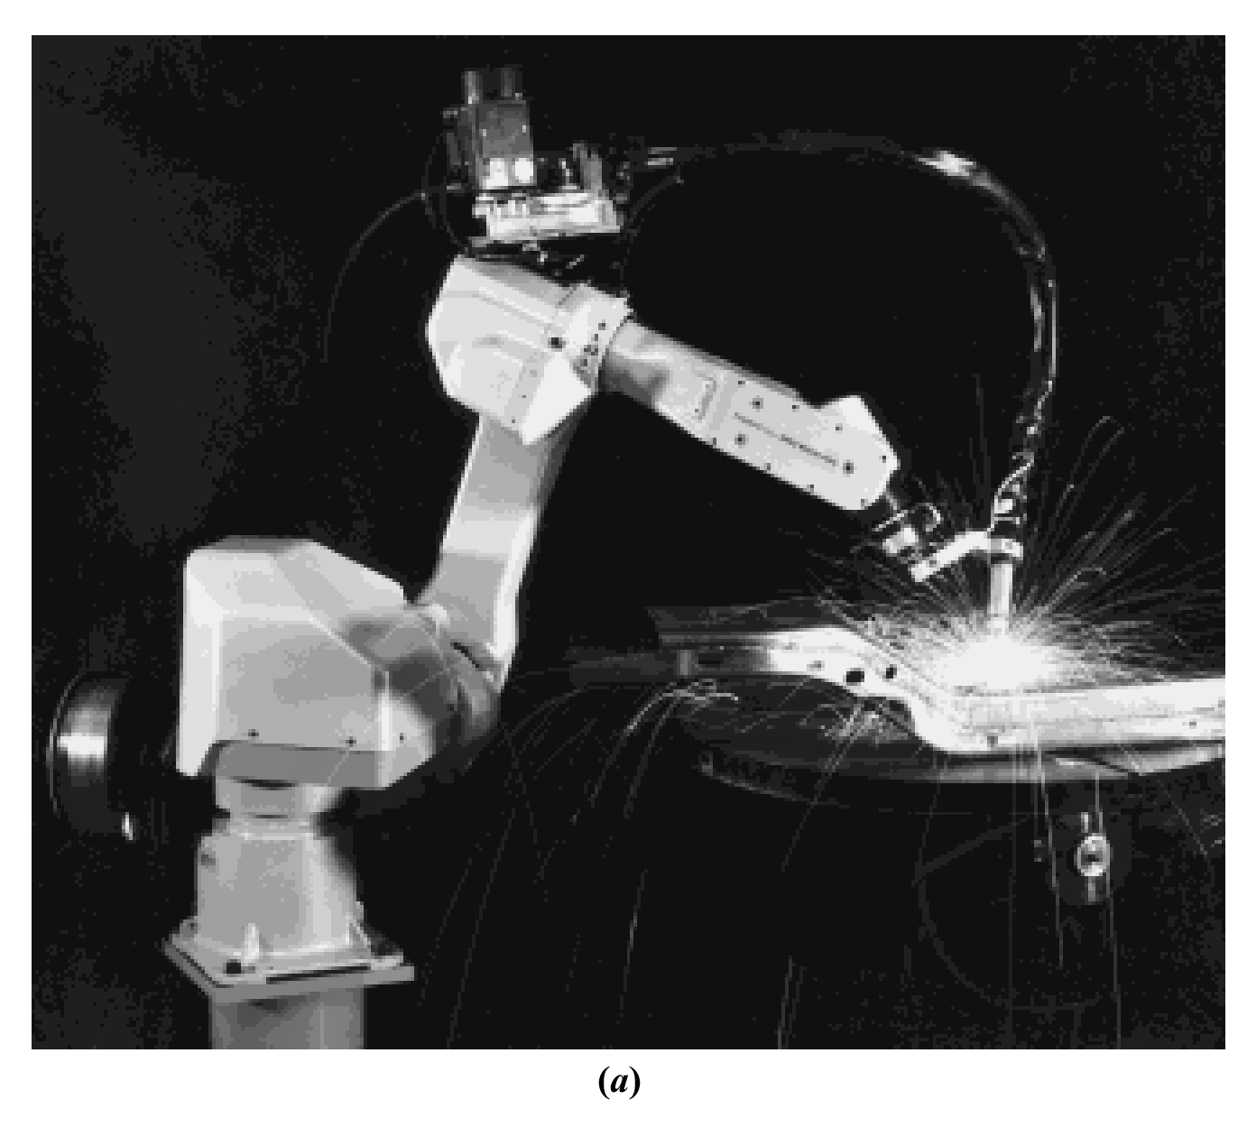
Figure P8.13
a. Robot equipped to
perform arc welding;
(figure continues)

Slide 48
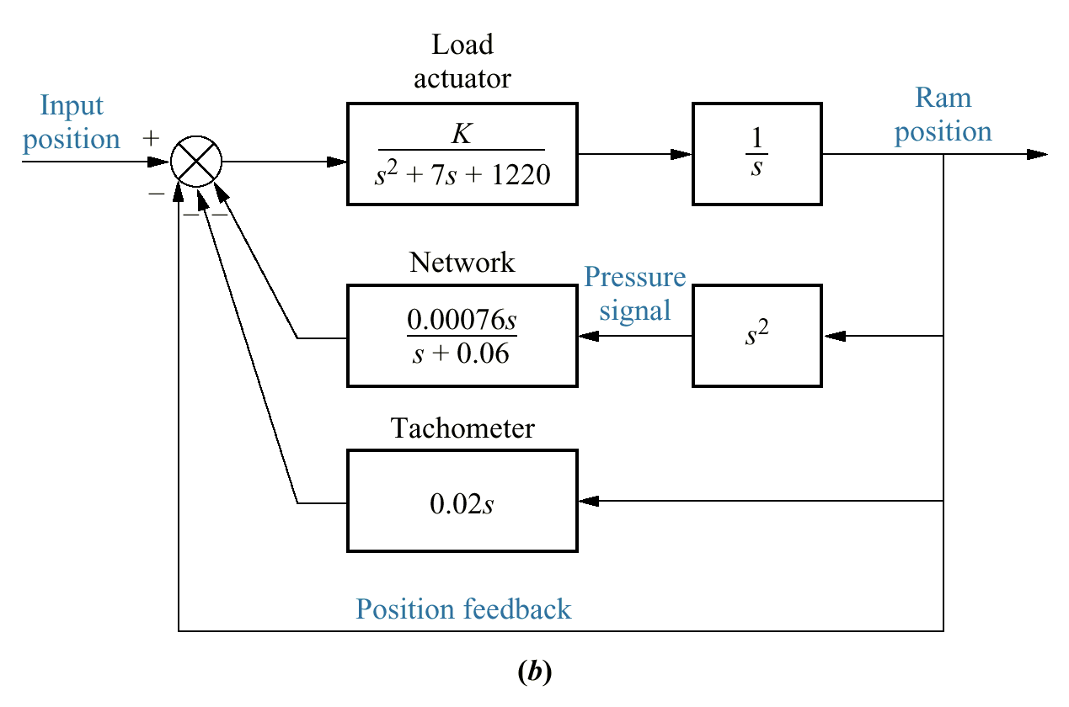
Figure P8.13
(continued)
b. block diagram for
swing motion system

Slide 49
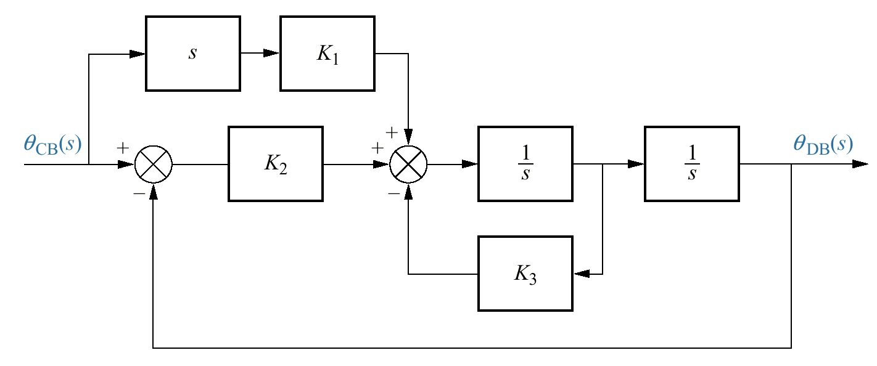
Figure P8.14
Block diagram of
smoother

Slide 50
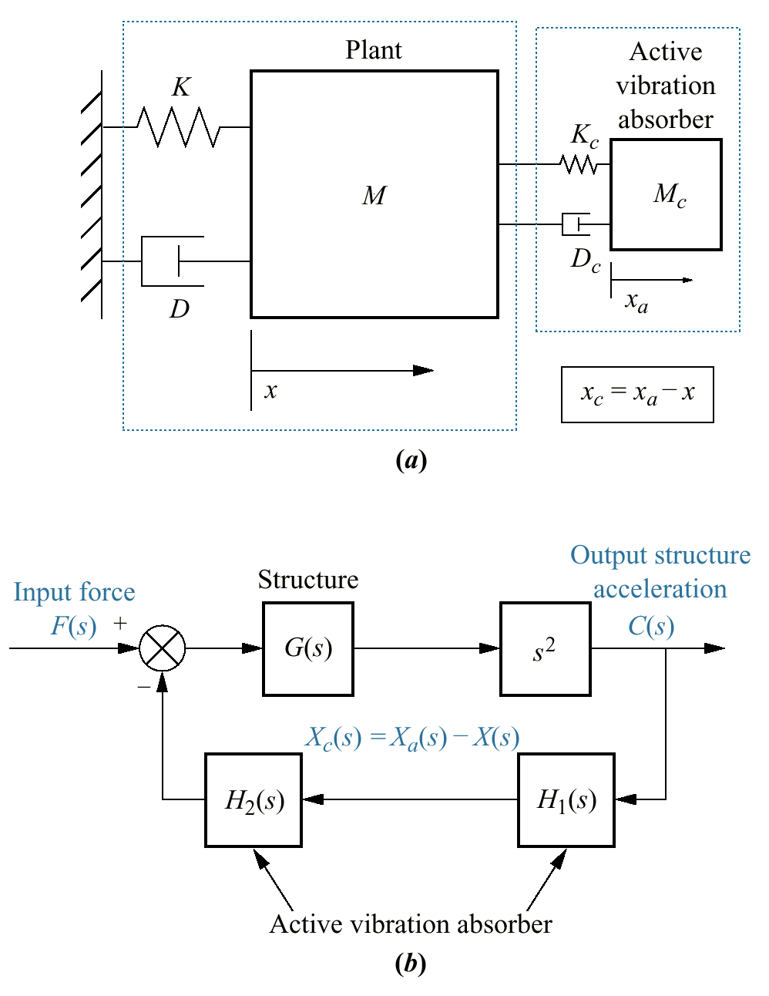
Figure P8.15
a. Active vibration
absorber
b. (1992 AIAA);
control system
block diagram

Slide 51
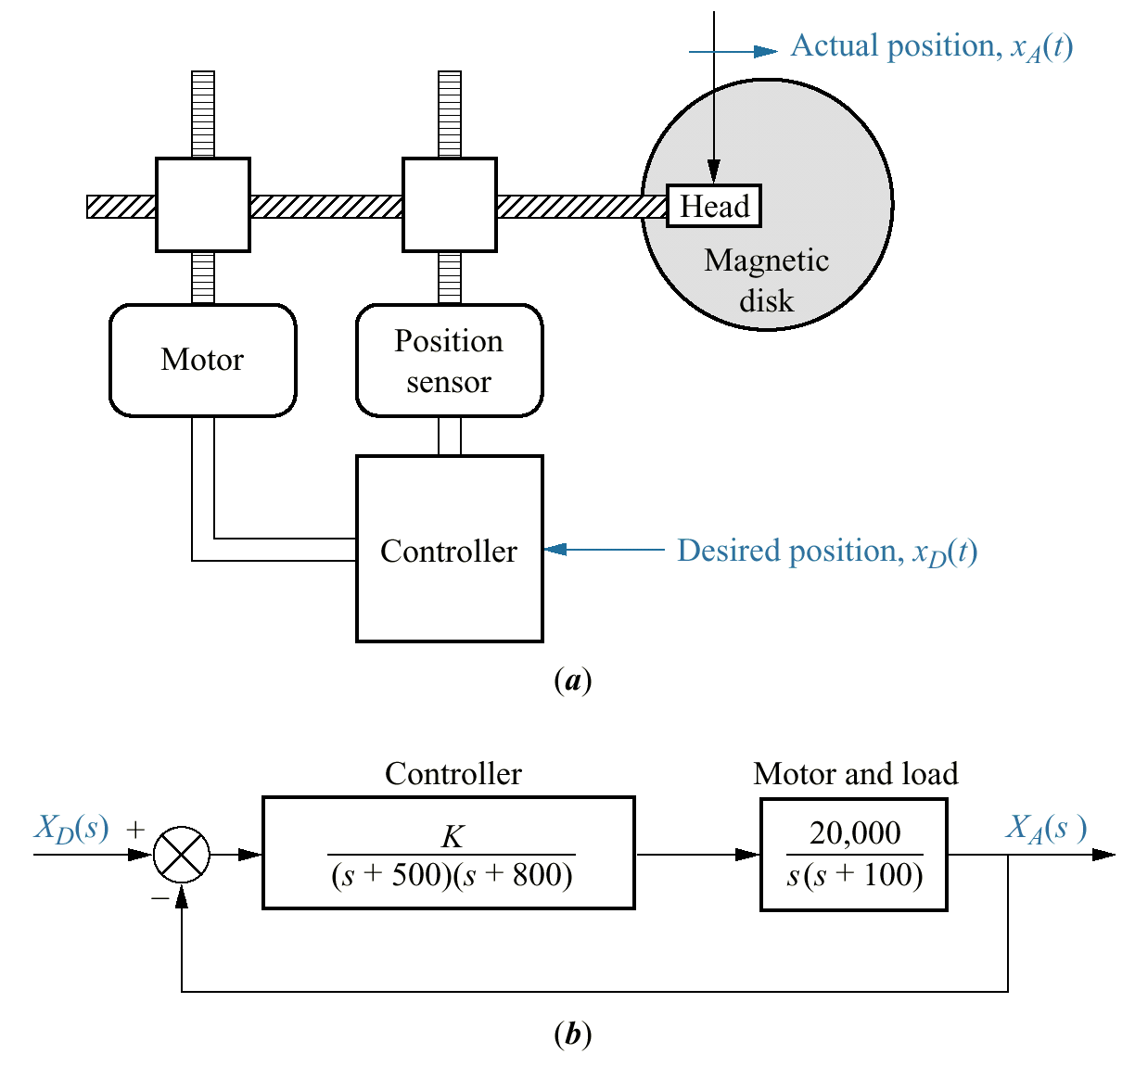
Figure P8.16
Floppy disk drive:
a. physical
representation;
b. block diagram

Slide 52

Figure P8.17
Simplified block
diagram of pupil
servomechanism

Slide 53

Figure P8.18
Active suspension
system

Slide 54

Figure P8.19
F4- E pitch
stabilization loop

Slide 55

Figure P8.20
Pitch axis attitude
control system
utilizing momentum
wheel

Slide 56

Figure P8.21
Combustor with
microphone and
loud speaker
a. (1995 IEEE);
b. block diagram
(1995 IEEE)

Slide 57

Figure P8.22
a. Wind turbines
generating electricity
near Palm Springs,
California (1998 IEEE);
(figure continues)

Slide 58


Figure P8.22
(continued)
b. Control loop for
a constant-speed
pitch-controlled
wind turbine
(1998 IEEE);
c. Drivetrain
(1998 IEEE)

